Slide 1

Machine learning project
Group 4
Bank Marketing
Nguyễn Hoàng Anh 20194417 - Nguyễn Minh Châu 20194421 – Chu Hoàng Dương 20194429

Slide 2
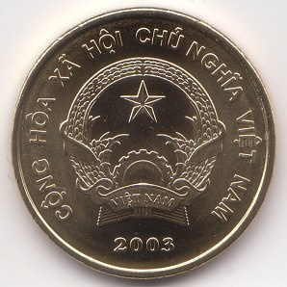

Content
Real application problem
Data overview
Data preprocessing
Experiment
Model performance and evaluation

Slide 3
Real application problem
1. Description
The problem is related with direct marketing campaigns of a Portuguese banking institution. The marketing campaigns were based on phone calls. Often, more than one contact to the same client was required, in order to access if the product (bank term deposit) would be (or not) subscribed.
2. Machine learning algorithms: Nearest neighbor learning, Decision tree classification
3. Dataset general description:
Data Set Characteristics: Multivariate
Number of Instances: 45211 for bank-full.csv
Area: Business
Number of Attributes: 16 + output attribute
Missing Attribute Values: None
Source: UCI Machine Learning Repository: Bank Marketing Data Set
The classification goal is to predict if the client will subscribe (yes/no) a term deposit (variable y).

Slide 4
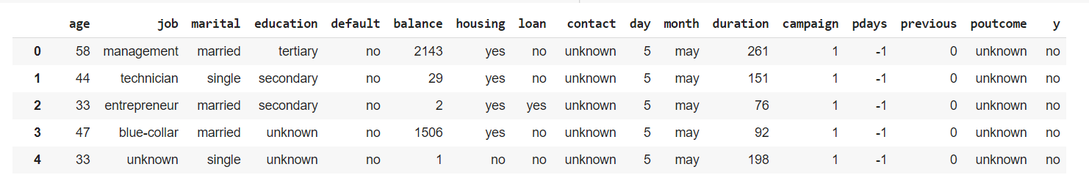
Attribute information
Bank client data
Current campaign data
Previous campaign data
output

Slide 5
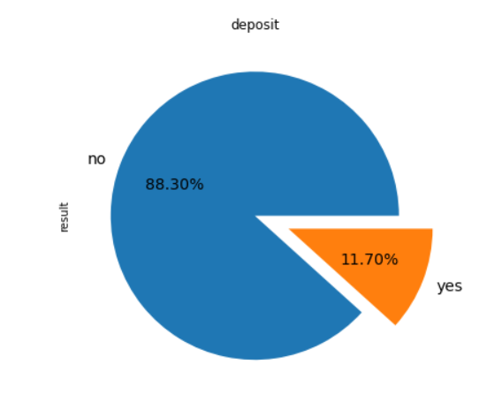
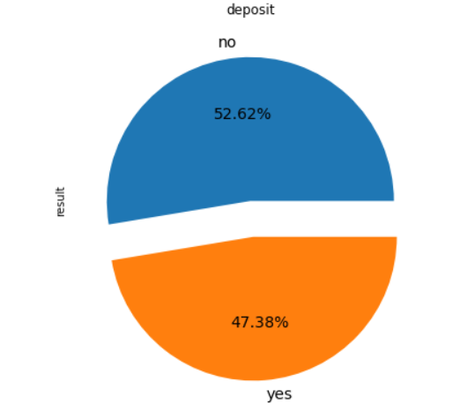
Data overview
Balanced
The initial proportion of each class label
The proportion of each class label after balance

Slide 6
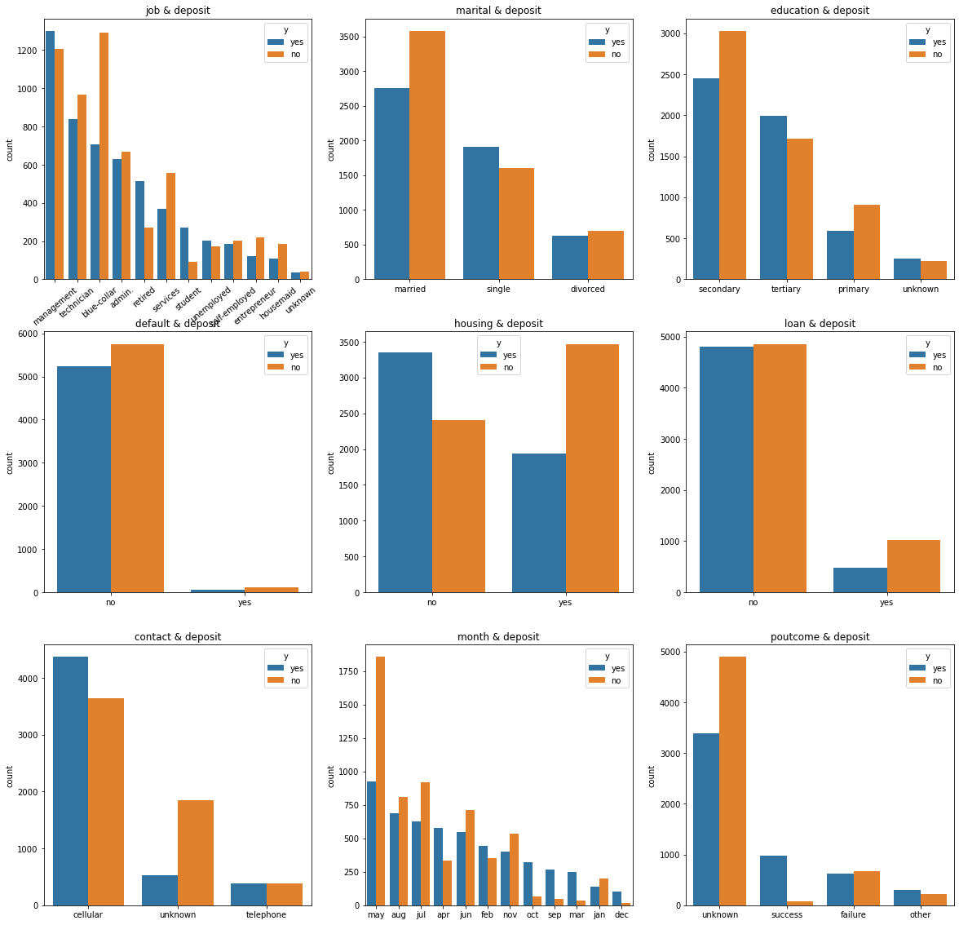
Categorical attribute
1. Unknown value:
Drop attributes
Replace by most frequency
2. “Yes – no” => binary
3. Convert categorical attributes to numeric(label encoding)
The distribution of label class for each attribute

Slide 7
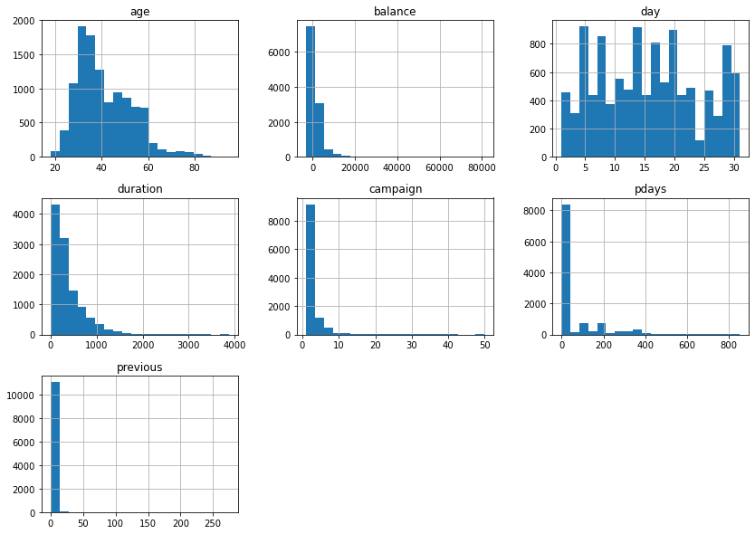
Numeric attributes
Massive range => categorize into distinct group levels.
Remove outliers
(more than three standard deviations away from the mean)
3. Investigate correlation
The distribution of numerical variables

Slide 8
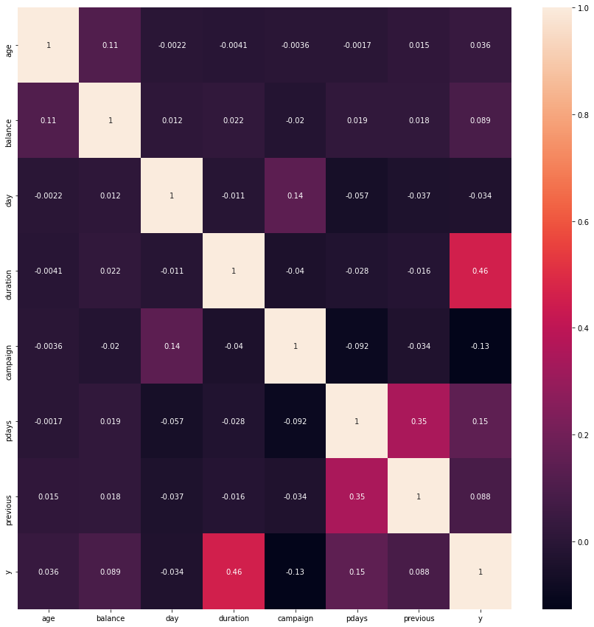
Numerical attributes
Correlation matrix
Observation:
Over numerical features have very less correlation between each other.
pdays and previous have high correlation.
duration has a high correlation with our target variable.

Slide 9
Data Preprocessing
Remove unrelated attributes( pdays, poutcome)
Transform into numerical attributes
Remove outliers
Standard Scaling data into range [0,1]
Split training set and test set
80%
20%

Slide 10
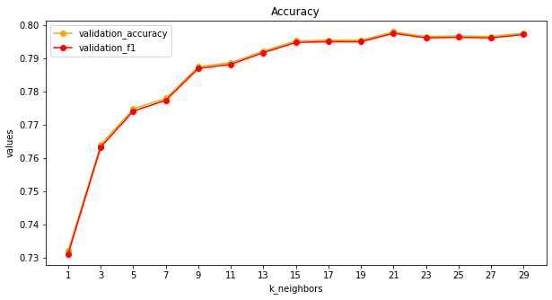
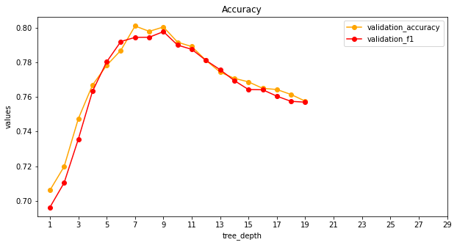
Experiment
Accuracy with different values of k
KNN model
Accuracy with different depth
Decision tree model

Slide 11
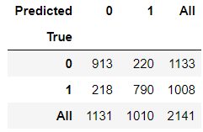
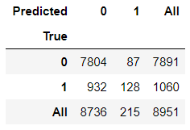
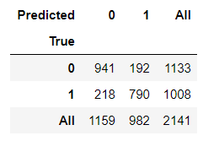
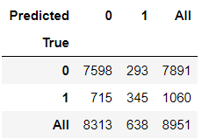
Model performance and evaluation
Model | Performance | Balanced Dataset | imbalanced Dataset
KNN | Test accuracy | 0.7954 | 0.8862
 | Test F1 score | 0.7829 | 0.2007
 | Confusion matrix
Decision Tree | Test accuracy | 0.8080 | 0.8873
 | Test F1 score | 0.7936 | 0.4064
 | Confusion matrix

Slide 12
Classification report
IMBALANCED DATASET
Metrics | KNN model | Decision tree model
Precision of 0 | 89% | 91%
Recall of 0 | 99% | 96%
Precision of 1 | 60% | 54%
Recall of 1 | 12% | 32%
For balanced data set, Decision Tree seems to be a better classifier
Regarding imbalanced dataset, the score metrics are similar
Both models are good to predict a customer’s response

Slide 13
Thank for watching !
Our git repo: duongDSAI64/ML-miniproject (github.com)

